Slide 4
Lighting the Christ Candle

Slide 5
The Lord be with you
And also with you

Slide 6
Let us
pass the peace

Slide 8
1 The Mighty One,
God, the LORD, speaks
and summons the earth from the rising of the sun to
the place where it sets.
2 From Zion, perfect in beauty, God shines forth.

Slide 9
3 Our God comes and will not be silent; a fire devours before Him,
and around Him a tempest rages.
4 He summons the heavens above, and the earth, that
He may judge His people:

Slide 10
5 "Gather to me my consecrated ones, who made a covenant with me
by sacrifice."
6 And the heavens proclaim
His righteousness,
for God himself is judge.

Slide 12
All glory, laud and honour
To You, O Christ, we sing, To whom the lips of children
Made sweet hosannas ring!
You are the King of Israel
You are David’s royal Son
Who came in the Lord’s name
As King and blessed one.1/5

Slide 13
All glory, laud and honour
To You, O Christ, we sing.
O Promised One of Israel,
Of David's royal line,
The company of angels
Are praising You on high
And mortals and all creatures
Exultant make reply.2/5

Slide 14
All glory, laud and honour
To You, O Christ, we sing.
As You received their praises,
Receive our prayers today,
The people of the Hebrews
with palms before You went
and prayer and anthems
we offer You this day. 3/5

Slide 15
All glory, laud and honour
To You, O Christ, we sing, To whom the lips of children
Made sweet hosannas ring!
To You before Your passion
They sang their hymns of praise
To You now exalted high
Our Melody of praise 4/5

Slide 16
All glory, laud and honour
To You Redeemer King
To whom the lips of children
Made sweet hosannas sing
You did receive our praises
Accept the prayers we bring
You delight in right living
Good Lord and gracious King.5/5
Theodulph of Orleans, words, trans. John Mason Neale Melchior Teschner, music (1584-1635)

Slide 19
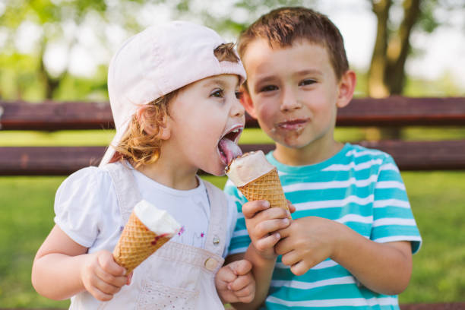

Slide 20
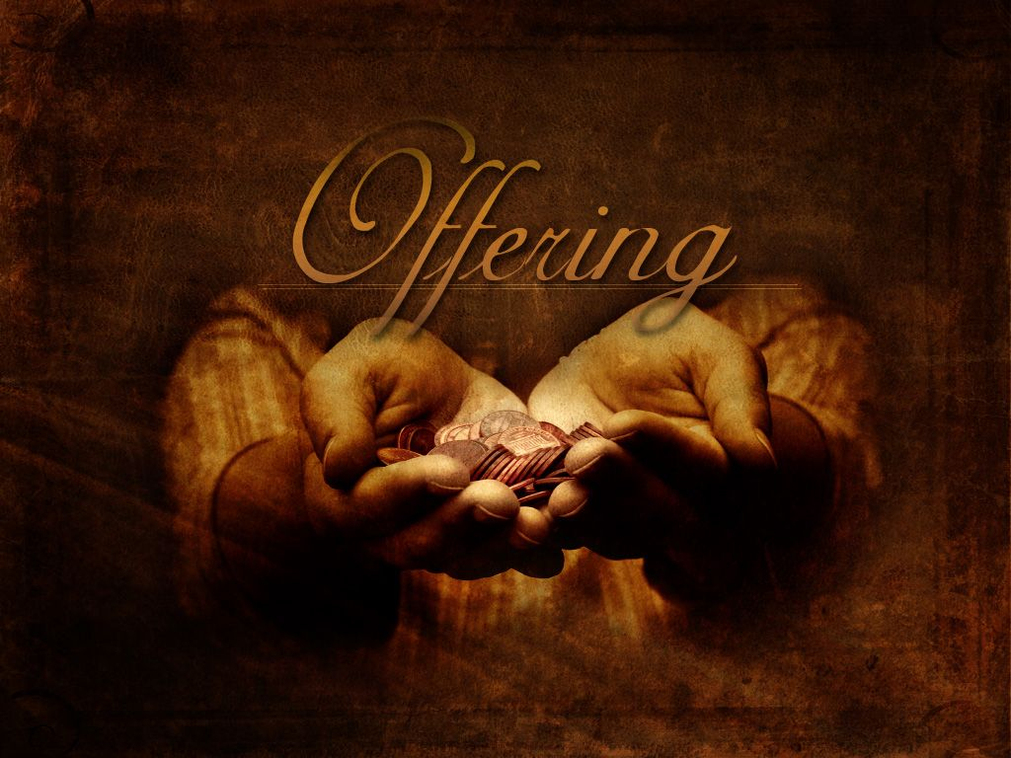

Slide 22
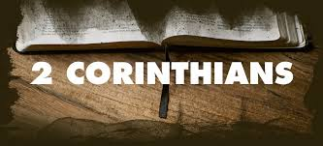

Slide 23
³ And even if our gospel is veiled,
it is veiled to those who are perishing.
⁴ The God of this age has blinded the minds of unbelievers, so that they cannot see the light of the gospel that displays the glory of Christ, who is the image of God.
⁵ For what we preach is not ourselves,
but Jesus Christ as Lord, and ourselves as your servants for Jesus’ sake.

Slide 24
⁶ For God, who said, “Let light shine out of darkness,” made his light shine in our hearts to give us the light of the knowledge of God’s glory displayed in the face of Christ.

Slide 25
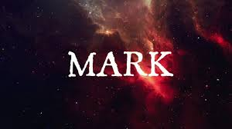

Slide 26
² After six days Jesus took Peter, James and John with him and led them up a high mountain, where they were all alone.
There he was transfigured before them.
³ His clothes became dazzling white, whiter than anyone in the world could bleach them.
⁴ And there appeared before them Elijah and Moses, who were talking with Jesus.

Slide 27
⁵ Peter said to Jesus, “Rabbi, it is good for us to be here. Let us put up three shelters—one for you, one for Moses and one for Elijah.”
⁶ (He did not know what to say, they were so frightened.)
⁷ Then a cloud appeared and covered them, and a voice came from the cloud:
“This is my Son, whom I love. Listen to him!”

Slide 28
⁸ Suddenly, when they looked around,
they no longer saw anyone with them except Jesus.
⁹ As they were coming down the mountain, Jesus gave them orders not to tell anyone what they had seen until
the Son of Man had risen from the dead.

Slide 30
How good, Lord, to be here!
Your glory fills the night;
Your face and garments like the sun,
Shine with unborrowed light.
1/5

Slide 31
How good, Lord, to be here, Your beauty to behold, Where Moses and Elijah stand, Your messengers of old.
2/5

Slide 32
Fulfiller of the past, Promise of things to be: We hail Your body glorified, And our redemption see.
3/5

Slide 33
Before we taste of death, We see Your kingdom come; We have to hold the vision bright, And make this hill our home.
4/5

Slide 34
How good, Lord, to be here! Yet we will not remain; But since You bid us leave the mount, Come with us to the plain.
5/5
Joseph Armitage Robinson 1853-1933

Slide 36
The Transfiguration is the turning point of Jesus’ ministry. Until now, Jesus has been teaching and healing. Now he will begin his journey to Jerusalem, where he will die.
The transfiguration reaffirms Jesus’ identity, reveals his glory, and calls the disciples to listen to him, but, the disciples remain blind throughout
Peter made a good start by identifying Jesus as the messiah (8:29), but his response to Jesus’ prediction of his death made it clear that he expected a different kind of messiah than Jesus has to offer.

Slide 37
This account parallels Moses at Sinai (Exod 24, 34).
• Three men accompanied Moses (Exod 24:9; Mk 9:2).
• A cloud covered the Mtn for six days, and God spoke from the cloud (Exod 24:16; Mk 9:2, 7).
• Moses saw, God’s glory (Exod 33:17-23; Mk 9:3).
• The skin of Moses’ face shone dazzling bright (Exod 34:30; Mk 9:3)
• The people of Israel were afraid (Exod 34:30).
• On coming down from the Mtn, Moses encountered faithless “disciples” (Exod 32:7-8; Mk 9:14-29).

Slide 38
² After SIX, possible reference to temple rituals, days Jesus took Peter, James and John with him and led them up a high mountain, it is usual to Up to encounter a god, God., where they were all alone, a lovely sense of solitude.
There he was transfigured, metamorphia, changed, more like an unveiling of his true identity, a glimpse of God’s glory, before them.

Slide 39
³ His clothes became dazzling white, whiter than anyone in the world could bleach them.
⁴ And there appeared before them Elijah , the prophet and Moses, the law giver, these both suffered because of their faith, who were talking with Jesus.

Slide 40
⁵ Peter said to Jesus, “Rabbi, so soon after calling Jesus messiah, a bit odd, it is good for us to be here, really, why would you say that?, we do fill a good silences with bumblings. Let us put up three shelters a need to do something, anything, oh, put the kettle on.—one for you, one for Moses and one for Elijah.”
⁶ (He did not know what to say, they were so frightened.) if in doubt, say nothing, or nod.

Slide 41
⁷ Then a cloud appeared, another encounter or presence of / with God, and covered them,
and a voice came from the cloud:
“This is my Son, whom I love, the same words as at his Baptism. Listen to him, Deut 18:15!” this is curious to them as they have been taught to listen to Moses and Elijah, and this is changed.

Slide 42
⁸ Suddenly, when they looked around,
they no longer saw anyone with them except Jesus.
⁹ As they were coming down the mountain, from an amazing experience, Jesus gave them orders not to tell anyone what they had seen until the Son of Man had risen from the dead. This is called the Messianic secret, all will be revealed at a future date….. How do you understand as a thing until later…..

Slide 45
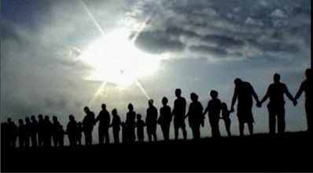
Prayers of the People

Slide 46
Our Father in heaven,
hallowed be Your name,
Your kingdom come,
Your will be done
On earth as in heaven.
Give us today our daily bread.

Slide 47
And forgive us our sins,
As we forgive those
who sin against us.
Save us from the time of trial,
And deliver us from evil.
For the kingdom, the power
and the glory are Yours,
Now and forever. Amen.

Slide 49
Lord, the light of your love is shining
In the midst of the darkness shining
Jesus light of the world
shine upon us
Set us free by the truth
you now bring us
Shine on me, shine on me.

Slide 50
Shine, Jesus, shine,
Fill this land with the Father's glory;
Blaze, Spirit, blaze,
Set our hearts on fire.
Flow, river, flow,
Flood the nations with grace and mercy;
Send forth Your word Lord,
And let there be light.

Slide 51
Lord, I come to Your awesome presence,
From the shadows into Your radiance;
By the blood
I may enter Your brightness
Search me try me,
consume all my darkness,
Shine on me, shine on me.

Slide 52
Shine, Jesus, shine,
Fill this land with the Father's glory;
Blaze, Spirit, blaze,
Set our hearts on fire.
Flow, river, flow,
Flood the nations with grace and mercy;
Send forth Your word Lord,
And let there be light.

Slide 53
As we gaze on Your Kingly brightness
So our faces display Your likeness,
Ever changing from glory to glory,
Mirrored here
may our lives tell Your story.
Shine on me, shine on me.

Slide 54
Shine, Jesus, shine,
Fill this land with the Father's glory;
Blaze, Spirit, blaze,
Set our hearts on fire.
Flow, river, flow,
Flood the nations with grace and mercy;
Send forth Your word Lord,
And let there be light.
CCLI 240211 used by permission

Slide 56
Morning Tea,
enjoy your week

Slide 57
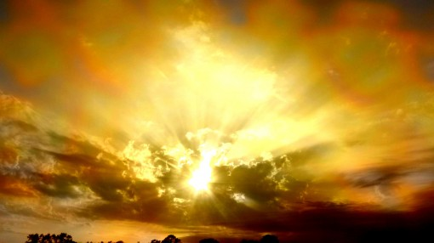
Postlude

